Slide 1
Attics, guesswork and clay. Sleuthing your way into Biomedical Natural Language Processing
Seth Russell, MS
University of Colorado Anschutz Medical Campus ACCORDS Data Science Program, D2V Data Science Core
https://github.com/magic-lantern/coprh-nlp-2021

Slide 2
Learning Objectives
A general idea of what Natural Language Processing (NLP) is.
A knowledge of the ethical implications of data reuse in NLP.
Knowledge of where to get text for NLP.
How to use and learn more about some basic NLP techniques.
https://github.com/magic-lantern/coprh-nlp-2021
Notes:
NLP is not simple or easy. You wont be an NLP expert after this presentation.
BUT, I hope that you have learned something interesting and want to pursue NLP further!

Slide 3
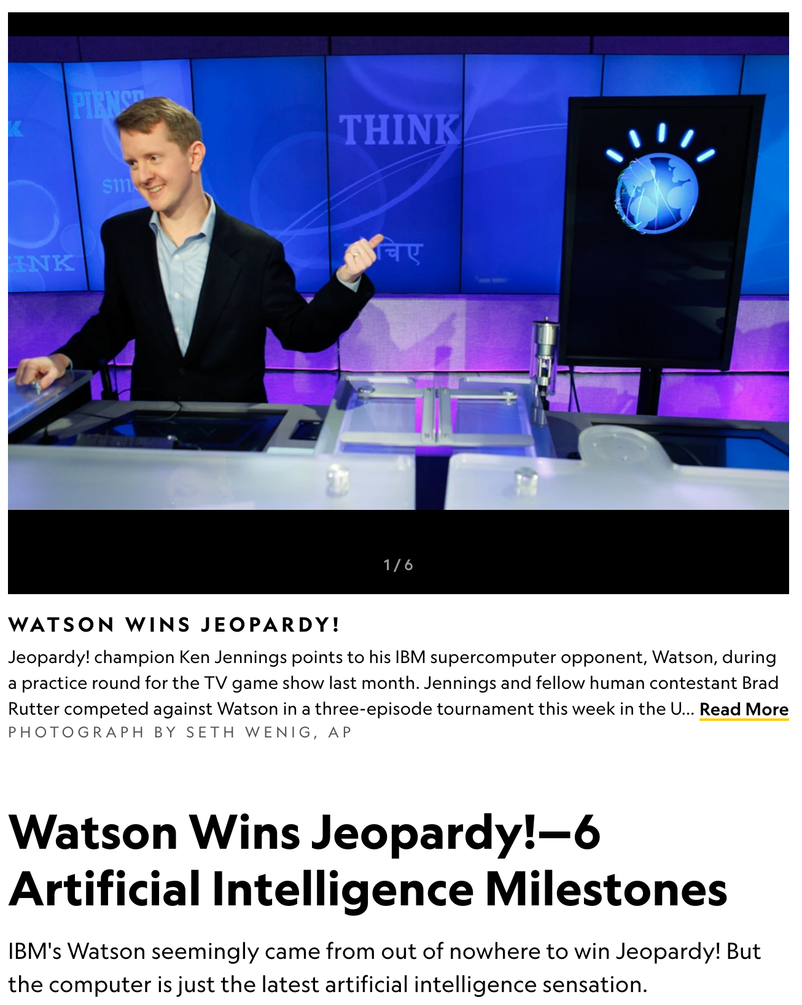
Notes:
Some of you may have heard of the many successes of Natural Language Processing. It has been highly lauded in the popular news as well as more academic circles for many years. One popular event about - described in this 2011 national geograpic article from 10 years ago was the match up of Jeopardy champion vs IBM's Question Answering system called "Watson" named for IBMs founder and first CEO Thomas J. Watson

Slide 4
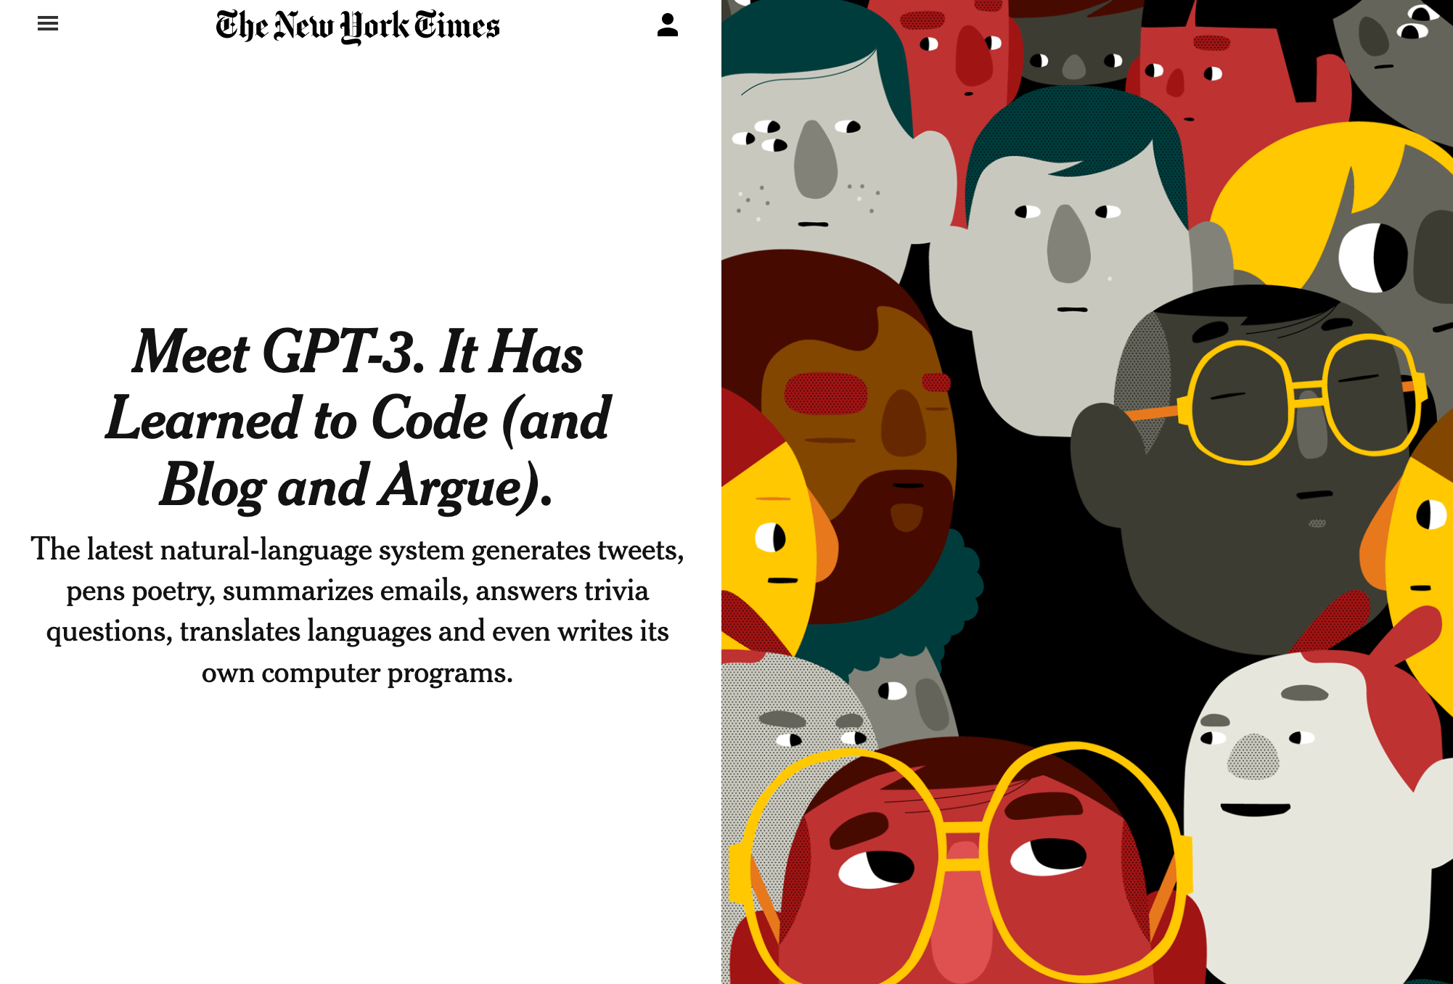
Notes:
More recently companies such as OpenAI - this image is from 2020 - have made additional breakthroughs that have caught popular imagination and fear in some cases for the ability for software to generate and appear to understand text.

Slide 5
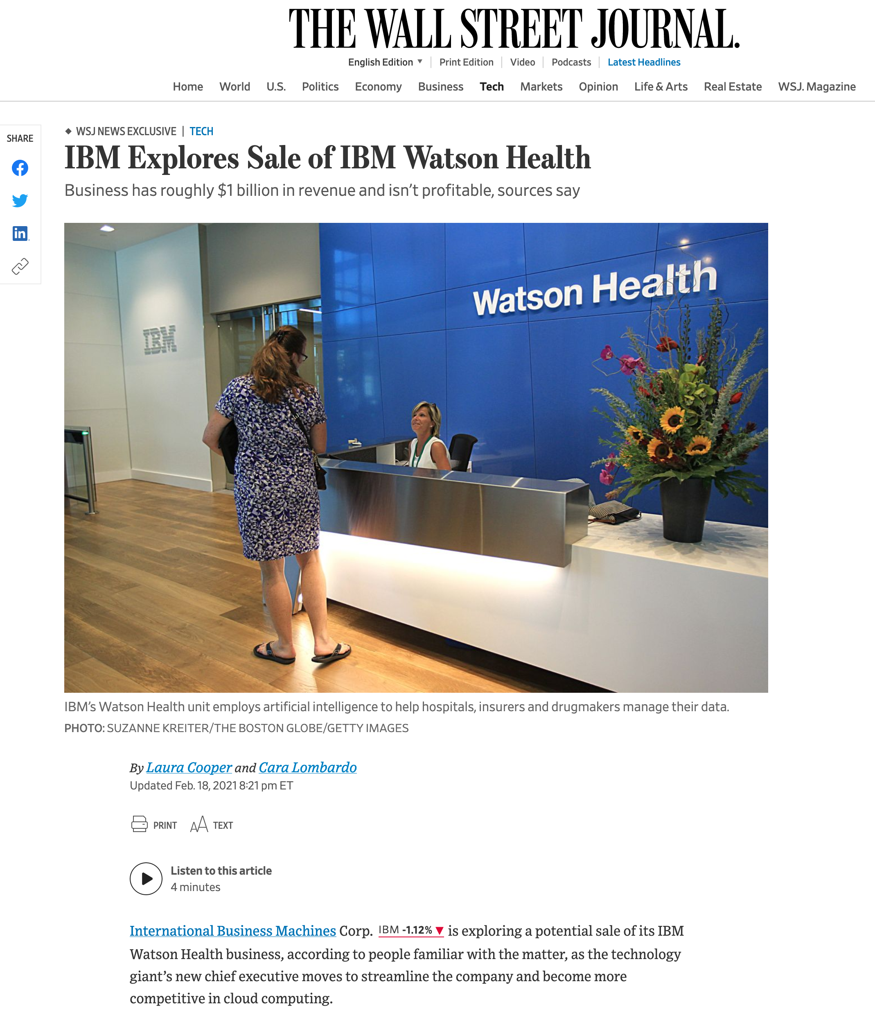
Notes:
As with any technology sometimes the hype doesn't live up to reality and as shown in this February 2021 article, even the amazing Watson may have to be put to pasture like a has been race horse.
openai gpt-3 training at least 4.6 million in hardware costs + many people and their wages
https://bdtechtalks.com/2020/09/21/gpt-3-economy-business-model/

Slide 6
“Come, Watson, come!” he cried. “The game is afoot. Not a word! Into your clothes and come!”
The Adventure of the Abbey Grange Sir Arthur Conan Doyle
https://github.com/magic-lantern/coprh-nlp-2021
Notes:
After seeing and hearing of the amazing things NLP can do, everyone wants to get into the game and see immediate advantages.

Slide 7
So, what is Natural Language Processing ?
Document Retrieval
Information Extraction
Knowledge Representation
Word/Concept/Abbreviation disambiguation
Automated reasoning
Classification
Sentiment Analysis
https://github.com/magic-lantern/coprh-nlp-2021
Notes:
Document Retrieval - Google
Information Extraction - This also can be seen in Google – see next slide
Knowledge Representation
Word/Concept/Abbreviation disambiguation
Automated reasoning
Classification and sentiment analysis – Skip ahead to next slide Content management systems to identify problem videos, posts, etc. Youtube, Facebook, Twitter and others are doing this

Slide 8
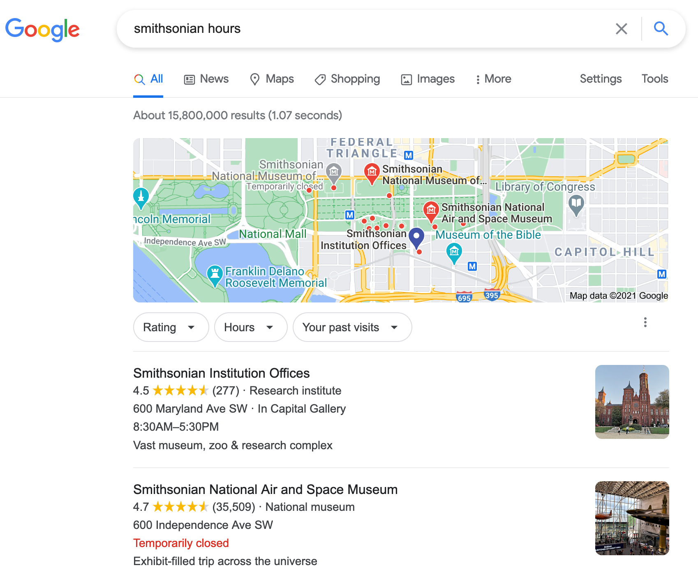
Notes:
This is an example of information extraction.

Slide 9
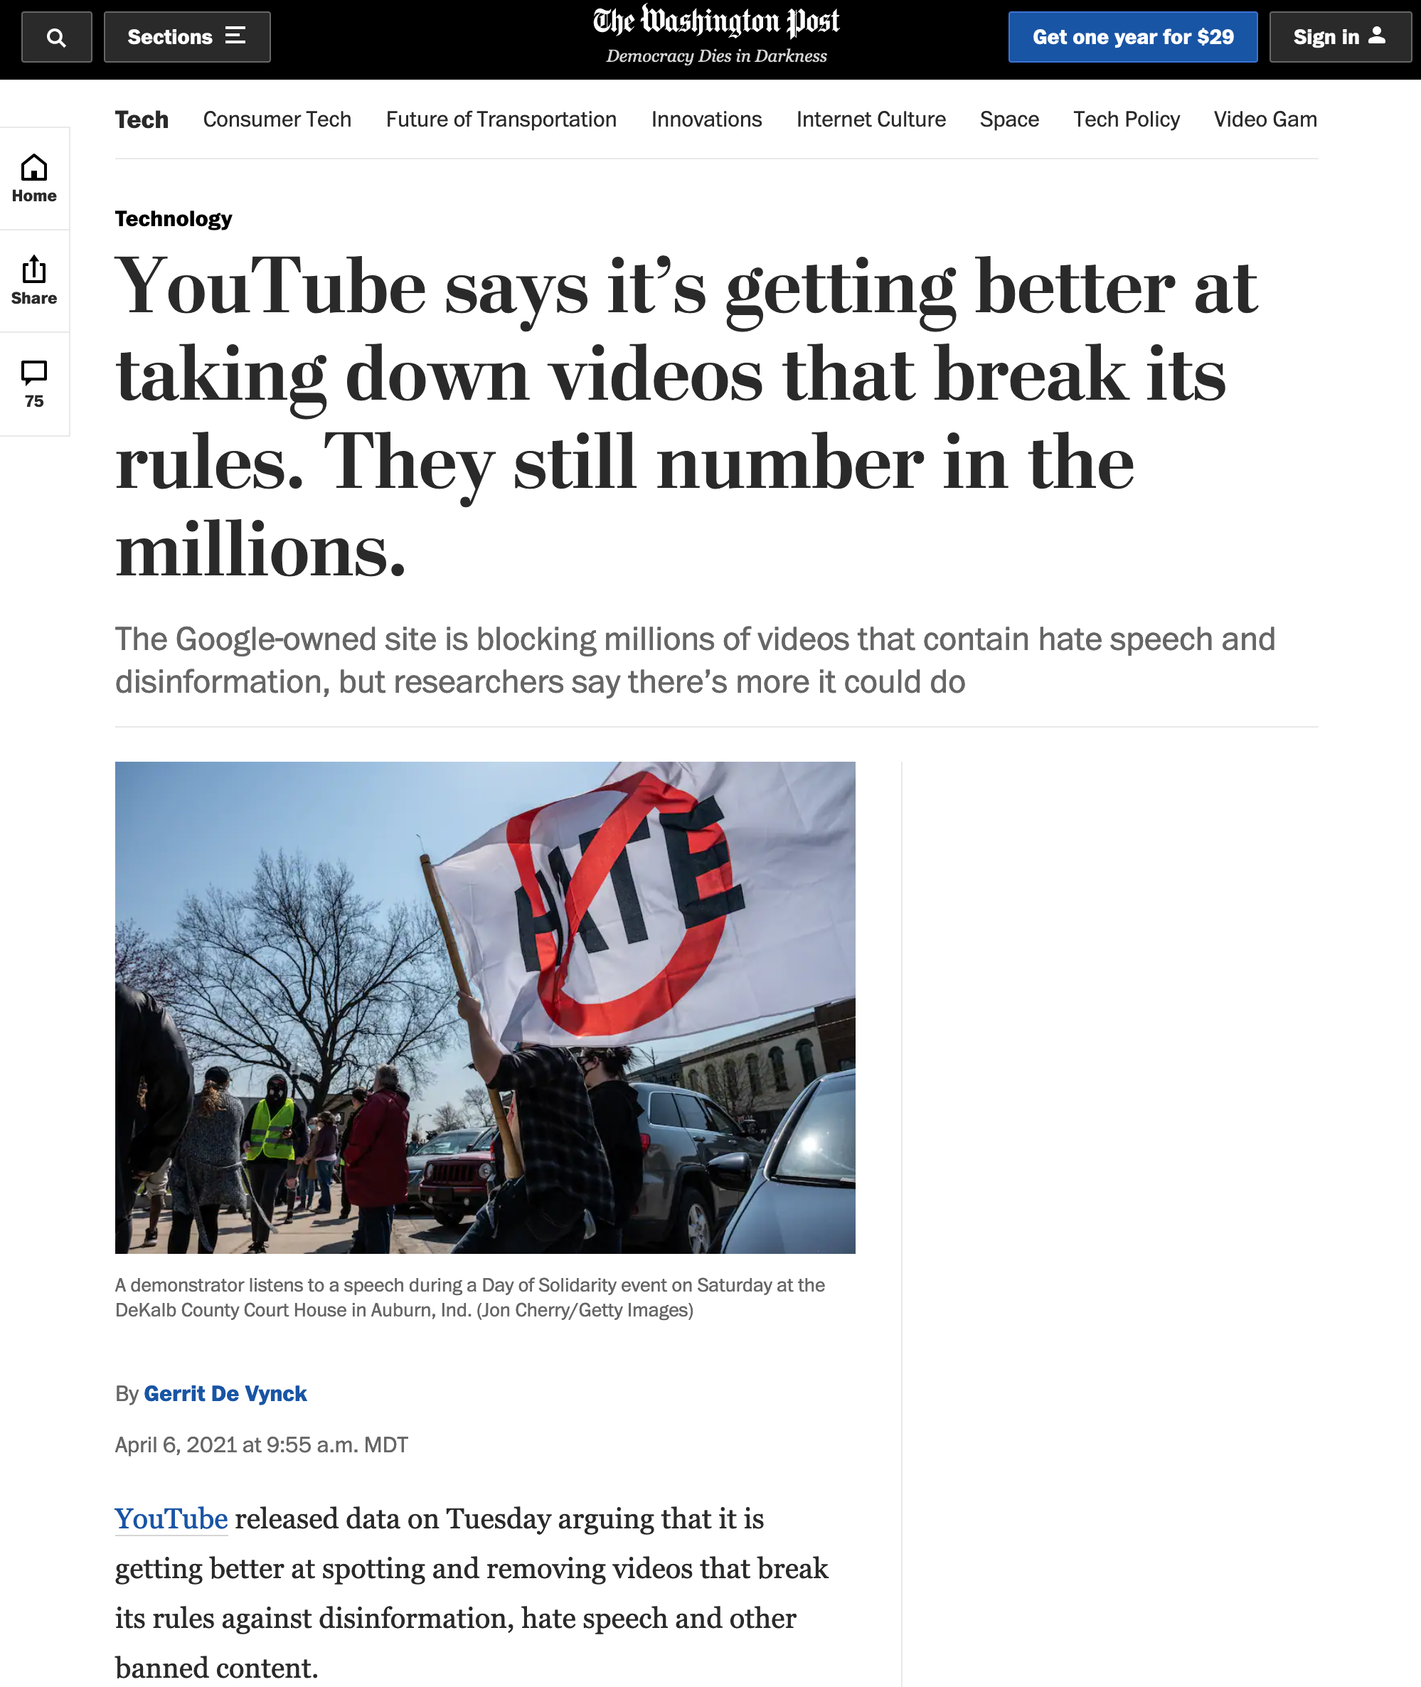
Notes:
This is a more advanced example that combines multiple NLP related technologies to essentially perform sentiment analysis.

Slide 10
I consider that a man’s brain originally is like a little empty attic, and you have to stock it with such furniture as you choose.
A fool takes in all the lumber of every sort that he comes across, so that the knowledge which might be useful to him gets crowded out, or at best is jumbled up with a lot of other things so that he has a difficulty in laying his hands upon it. Now the skilful workman is very careful indeed as to what he takes into his brain-attic. He will have nothing but the tools which may help him in doing his work, but of these he has a large assortment, and all in the most perfect order. It is a mistake to think that that little room has elastic walls and can distend to any extent. Depend upon it there comes a time when for every addition of knowledge you forget something that you knew before. It is of the highest importance, therefore, not to have useless facts elbowing out the useful ones.
A Study In Scarlet Sir Arthur Conan Doyle
https://github.com/magic-lantern/coprh-nlp-2021
Notes:
Historically, NLP systems were rule based - either rules based on grammar or rules based on matching specific words and phrases. Any domain expert can identify common words and phrases that could be used to identify specific elements in text for example. More specialized NLP experts where often Linguists - computational linguists - who codified rules of English and created complex sentence parse trees to then identify where information of a certain type would be found. It's my semi-educated guess that the rule based type of NLP is probably the most common and most popular.
Next we get into how to fill your brain with techniques and tools for natural language processing

Slide 11
Some common NLP techniques
Regular expressions
Syntactical Analysis
Stemming
Lemmatization
Stop word removal
Word to vector representations
Deep Learning & Language Models
https://github.com/magic-lantern/coprh-nlp-2021
Notes:
Regular expressions - Text pattern matching language – skip ahead to show this
Stemming - Removing common endings to words such as 's', 'ed', 'ing' to get the word stem
Lemmatization - 'to walk' may appear as 'walk', 'walked', 'walks' or 'walking'
Stop word removal - Removing high frequency, low meaning words.
Word to Vector - Most machine learning techniques require numeric input. There are various algorithms for converting words to numbers in a high dimensional vector space

Slide 12
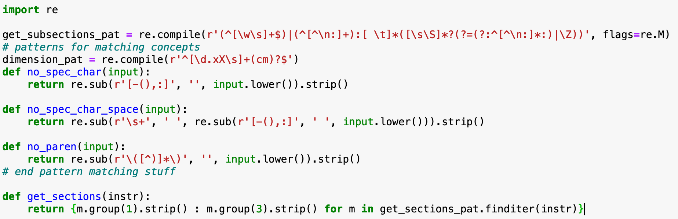
Regular Expressions
https://github.com/magic-lantern/coprh-nlp-2021

Slide 13
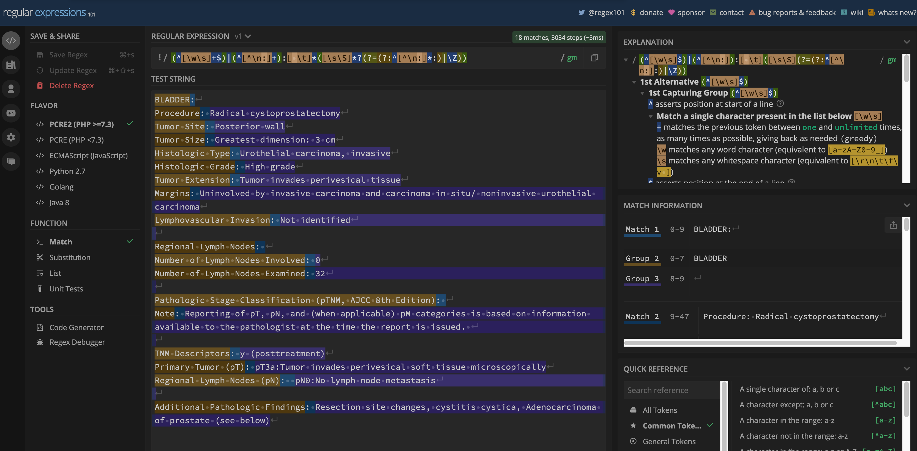
Regular Expressions
https://github.com/magic-lantern/coprh-nlp-2021

Slide 14
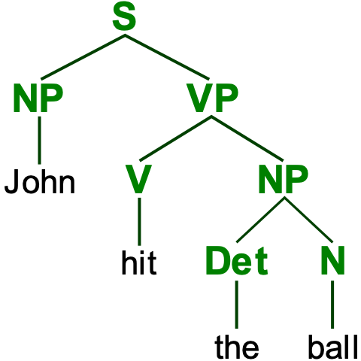
Notes:
consider the sentence "John hit the ball" Breaking this down into nouns, verbs, etc you come up with a structure like this which is how linguists explain how your brain makes sense of a sentence.
Depending on the project, similar regular expressions to those shown previously can be employed to split text into sentences as that is a logical grouping of ideas in language. Many NLP Pipelines start with a sentence detector and build from there.
This understanding of the structure of language is an important part of linguistics and also language modeling.
From Wikipedia:
A statistical language model is a probability distribution over sequences of words. Given such a sequence, say of length m, it assigns a probability to the whole sequence.
The language model provides context to distinguish between words and phrases that sound similar. For example the phrases "recognize speech" and "wreck a nice beach" sound similar, but mean different things.
Sparsity is a major problem in building language models. Most possible word sequences are not observed in training. One solution is to make the assumption that the probability of a word only depends on the previous n words. This is known as an n-gram model or unigram model when n = 1. The unigram model is also known as the bag of words model.
Estimating the relative likelihood of different phrases is useful in many natural language processing applications, especially those that generate text as an output. Language modeling is used in speech recognition,^{[1]} machine translation,^{[2]} part-of-speech tagging, parsing,^{[2]} Optical Character Recognition, handwriting recognition,^{[3]} information retrieval and other applications.
After show parse tree go back to list.

Slide 15
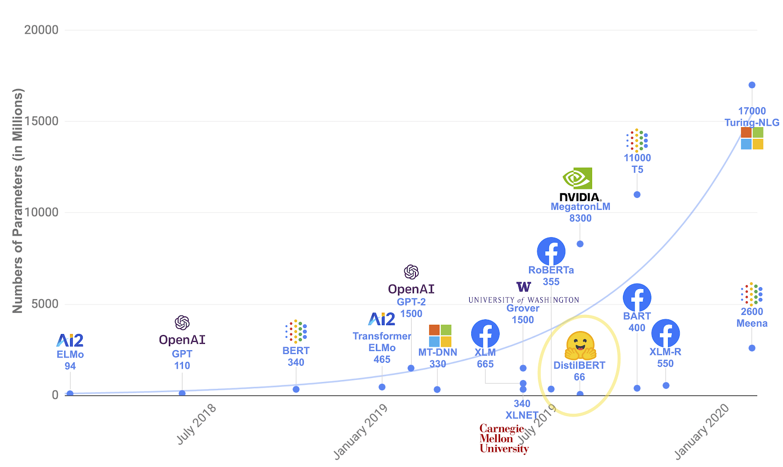
Source https://research.aimultiple.com/gpt/

Slide 16
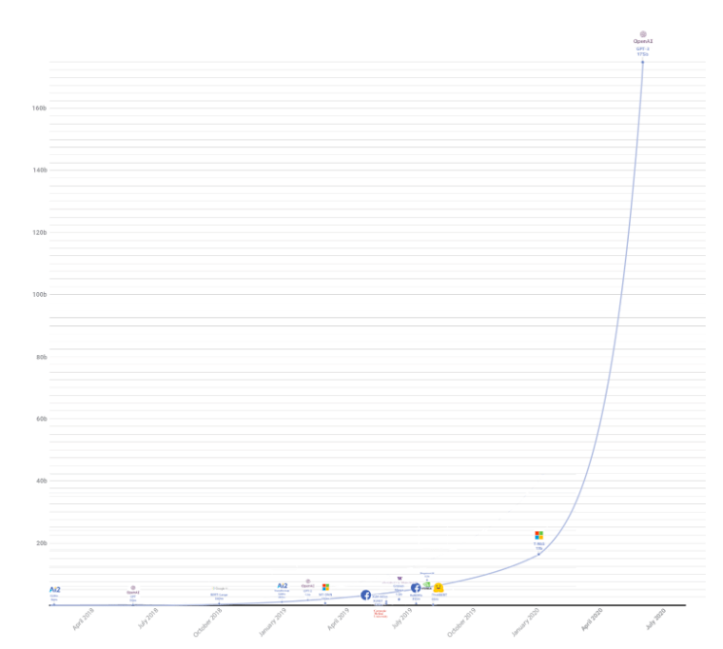

Slide 17
Language Modeling – Self Supervised
Given the sentence: John hit the ball
_____ hit the ball
John _____ the ball
John hit _____ ball
John hit the _____
_THE_ hit the ball
John _BE_ the ball
John hit _A_ ball
John hit the _OF_
_YOU_ hit the ball
John _ATE_ the ball
John hit _MY_ ball
John hit the _CAR_

Slide 18
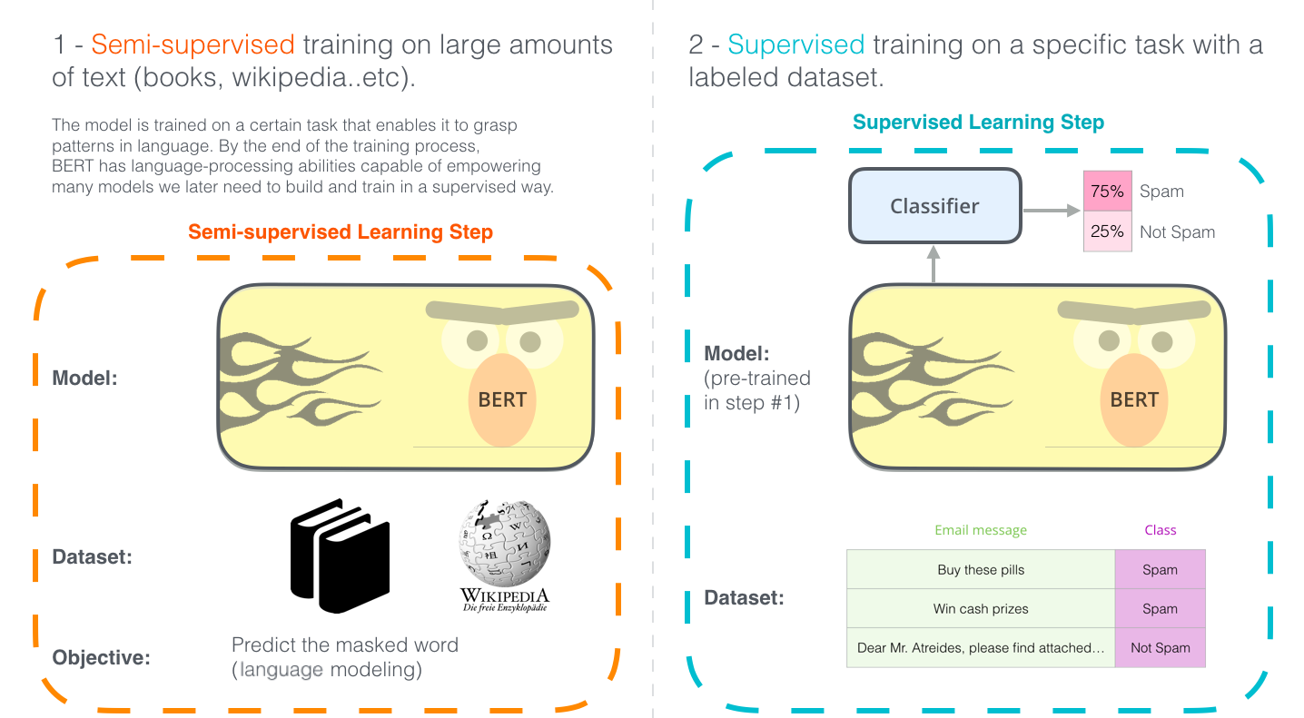

Slide 19
Language Model based concept matching
Given the phrase: “Number of Lymph Nodes Involved/ Examined”
top F1 results: tensor([0.9105, 0.9044, 0.7661]) top F1 matches:
'number of lymph nodes involved’
'number of lymph nodes examined’
'no lymph nodes submitted or found'
https://github.com/magic-lantern/coprh-nlp-2021

Slide 20
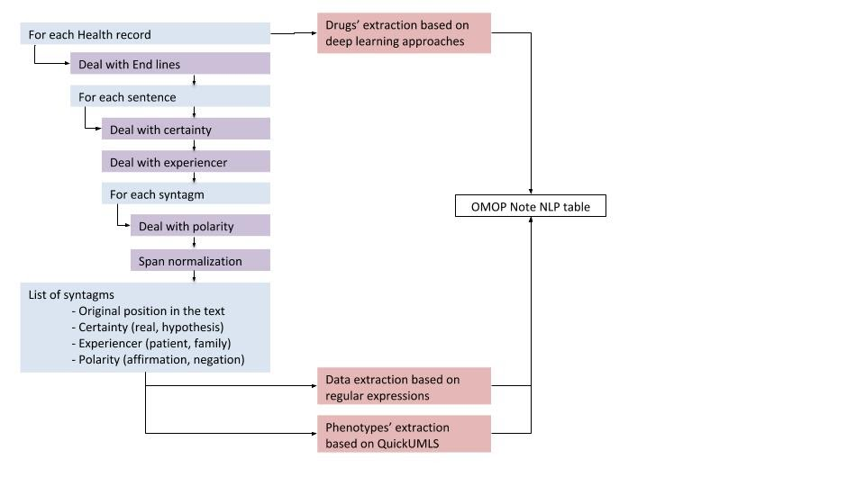
Practical NLP - Pipelines
https://doi.org/10.2196/20773

Slide 21
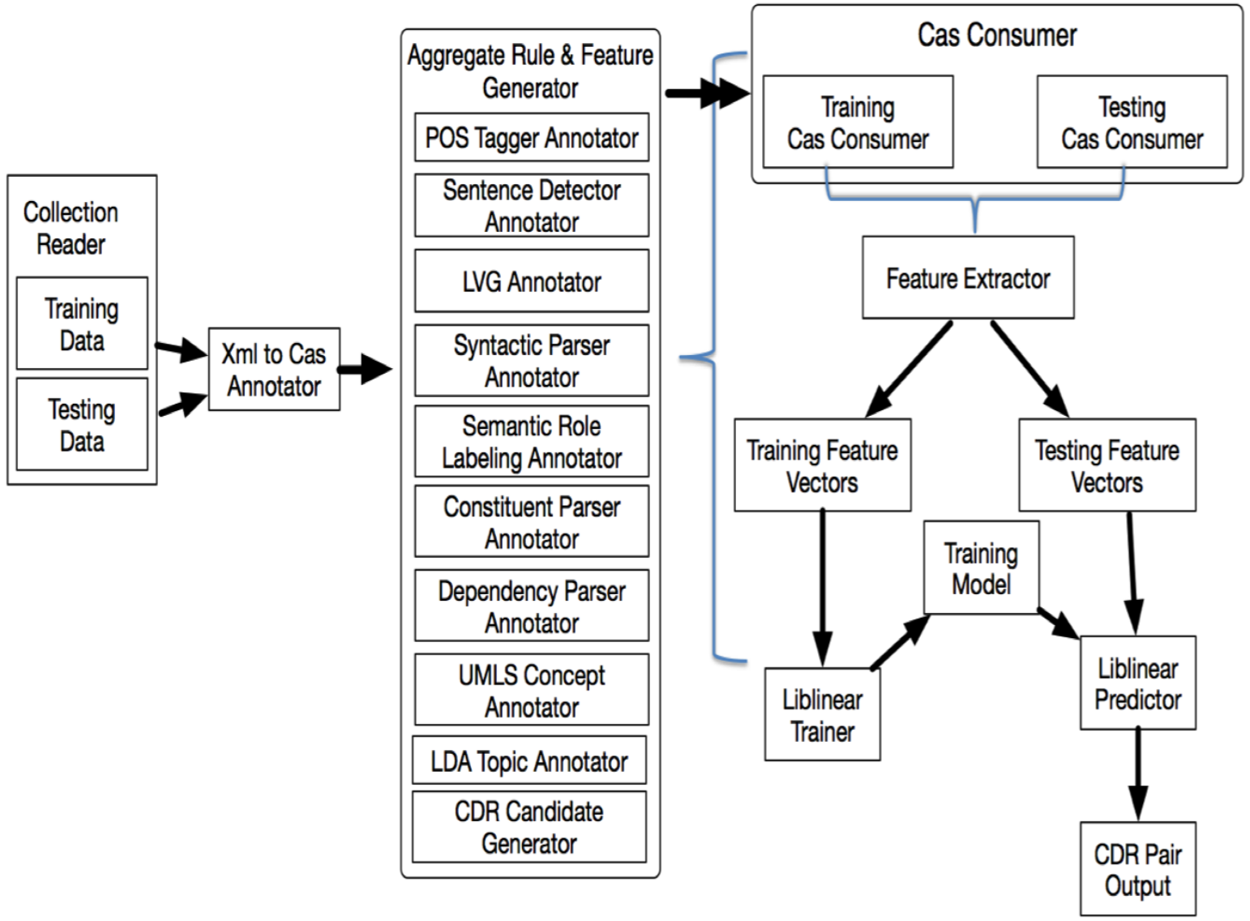
Practical NLP - Pipelines
Resolution of Chemical Disease Relations with Diverse Features and Rules

Slide 22
“We are coming now rather into the region of guesswork,” said Dr. Mortimer. Holmes' reply: “Say, rather, into the region where we balance probabilities and choose the most likely. It is the scientific use of the imagination, but we have always some material basis on which to start our speculation.”
The Hound of the Baskervilles
Sir Arthur Conan Doyle
https://github.com/magic-lantern/coprh-nlp-2021
Notes:
With a little bit of information on what is considered NLP, where do we go now?

Slide 23
Ethics in NLP
ACM Code of Ethics and Professional Conduct
Association for Computing Machinery, 2018
Computing professionals' actions change the world. To act responsibly, they should reflect upon the wider impacts of their work, consistently supporting the public good. The ACM Code of Ethics and Professional Conduct ("the Code") expresses the conscience of the profession...
https://github.com/magic-lantern/coprh-nlp-2021

Slide 24
1. GENERAL ETHICAL PRINCIPLES.
A computing professional should...
Contribute to society and to human well-being, acknowledging that all people are stakeholders in computing
Avoid harm.
Be honest and trustworthy.
Be fair and take action not to discriminate.
Respect the work required to produce new ideas, inventions, creative works, and computing artifacts.
Respect privacy.
Honor confidentiality.
Continued at https://www.acm.org/code-of-ethics
https://github.com/magic-lantern/coprh-nlp-2021

Slide 25
“Data! data! data!” he cried impatiently. “I can’t make bricks without clay.”
The Adventure of the Copper Beeches Sir Arthur Conan Doyle
https://github.com/magic-lantern/coprh-nlp-2021

Slide 26
Sources of text for NLP
CU Anschutz Health Data Compass - With IRB Approval can access many clinical notes from UC Health and Children's Hospital of Colorado https://www.healthdatacompass.org/
PhysioNet (MIMIC et al) https://physionet.org/about/database/
Other Text Sources
Kaggle https://www.kaggle.com/datasets
Hugging Face https://huggingface.co/datasets
Amazon product reviews and ratings http://jmcauley.ucsd.edu/data/amazon/
Twitter https://developer.twitter.com/en/products/twitter-api
https://github.com/magic-lantern/coprh-nlp-2021

Slide 27
It is a capital mistake to theorise before one has data. Insensibly one begins to twist facts to suit theories, instead of theories to suit facts.
A Scandal in Bohemia Sir Arthur Conan Doyle
Notes:
I’ve told you about various NLP techniques, but that isn’t enough to actually do NLP work. It will take lots of effort and learning to better understand these principles and being to apply them to your research.

Slide 28
Resources - Tutorials
"Clinical Natural Language Processing" Laura K. Wiley, PhD Asst Prof @ CU Anschutz https://www.coursera.org/learn/clinical-natural-language-processing
"Natural Language Processing Specialization" https://www.deeplearning.ai/program/natural-language-processing-specialization/
"A Code-First Introduction to Natural Language Processing" https://www.fast.ai/2019/07/08/fastai-nlp/
https://towardsdatascience.com/introduction-to-clinical-natural-language-processing-predicting-hospital-readmission-with-1736d52bc709
Medical Transcription Classification: https://www.kaggle.com/ritheshsreenivasan/clinical-text-classification
https://github.com/magic-lantern/coprh-nlp-2021

Slide 29
Resources - Books
"Introduction to Information Retrieval" https://nlp.stanford.edu/IR-book/
"Speech and Language Processing" https://web.stanford.edu/~jurafsky/slp3/
"Deep Learning for Coders with Fastai and PyTorch" https://book.fast.ai
https://github.com/magic-lantern/coprh-nlp-2021

Slide 30
Resources - NLP Libraries
https://spacy.io/ - Python
http://www.nltk.org/ - Python
https://opennlp.apache.org/ - Java
https://github.com/magic-lantern/coprh-nlp-2021

Slide 31
Resources – NLP Researchers/Teachers at CU
James Martin, Ph.D. @ CU Boulder
Larry Hunter, Ph.D. @ CU Anschutz
Laura K. Wiley, PhD @ CU Anschutz
https://github.com/magic-lantern/coprh-nlp-2021

Slide 32
Questions?
https://github.com/magic-lantern/coprh-nlp-2021

